Slide 1


USMC Records Management
EVERYONE’ S RESPONSIBILITY
V E R S I O N 1 . 1 / 9 SEPTEMBER 2 0 2 0

Slide 2
Introduction
Records are created across every MOS and throughout every facet of the Marine Corps.
Their management is not strictly an administrative function, created and managed only by the G-1 and S-1 sections. EVERYONE – regardless of rank or billet – handles records, and EVERYONE is obligated to manage and dispose of them according to federal mandates.
The key to records management (RM) is knowing what records you have,
where they are, and how long they must be kept!

Slide 3
Objectives
Upon the completion of this training you will be able to: Distinguish between records and non-records Understand current RM policy requirements
Identify your responsibility in the creation, use, maintenance, disposition, and preservation of records
Identify the tools/resources needed in order to apply best practices for the
management of records and to ensure RM program compliance

Slide 4
What is a Record?
Records consist of all recorded information, regardless of form or characteristics, made or received by a Federal agency under Federal law or in connection with the transaction of public business and preserved or appropriate for preservation by that agency or its legitimate successor as evidence of the organization, functions, policies, decisions, procedures, operations, or other activities of the United States Government or because of the informational value of data in them. (44 U.S.C. Sec. 3301)

Slide 5
What is a Record?
Examples include:
Organizational Charts Annual Reports Directives/Policy Application Design Photos
Emails
General Correspondence Audit/Inspection Reports Legal opinions/decisions Handbooks and Manuals Education and training logs

Slide 6
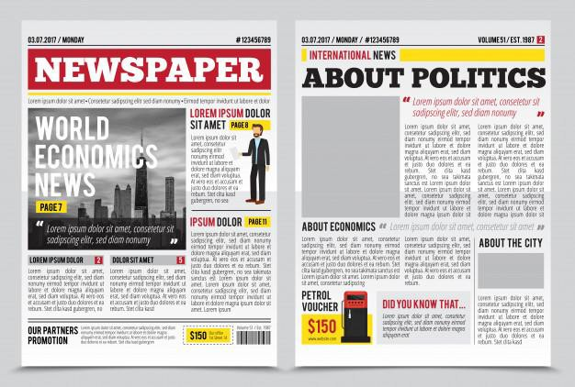
What is a Record?
Non-Records are:
Documentary materials excluded from the
legal definition of records
Copies of documents received for information that do not require action
Unofficial copies of documents kept for
convenience or reference
Materials needed for exhibition in libraries Articles, journals, working documents (i.e.
rough drafts, notes, cards etc.)

Slide 7

What is a Record?
Non-Records are:
Routing/transmittal sheets that add no information to the
transmitted material
Personal papers or notes which are not prepared for, used for, or communicated during government business
The “personal papers” category does not apply to
calendars, appointment books, schedules, logs, diaries,
Shopping List:
Item 1
Item 2
Item 3
and other records documenting meetings, appointments, telephone calls, trips, visits, and other activities of Federal employees while serving in an official capacity, if they are prepared for, used for, circulated, or communicated during Government business

Slide 8








What is Records Management?
RM is the management of information in organizations as records are created, maintained, used, retained, stored, inspected, destroyed or preserved.
RM enables the Marine Corps to be more efficient, accountable, responsive, and operationally effective.
CREATING
MAINTAINING
STORING
INSPECTING
DESTROYING
PRESERVING
Records Management

Slide 9
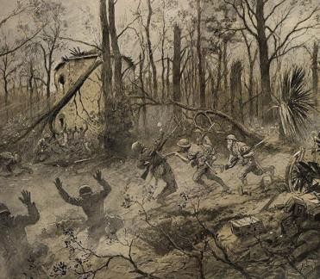
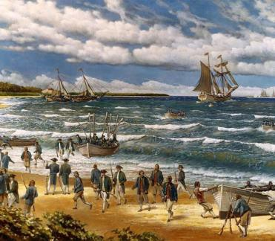
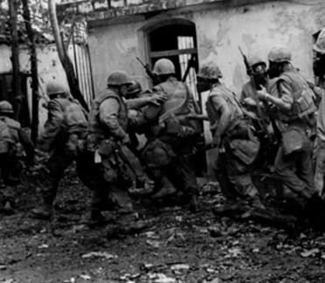
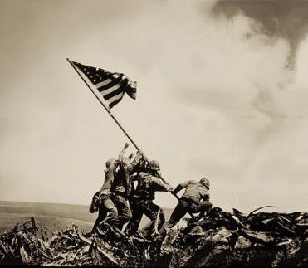
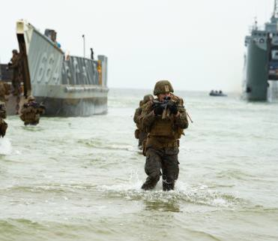
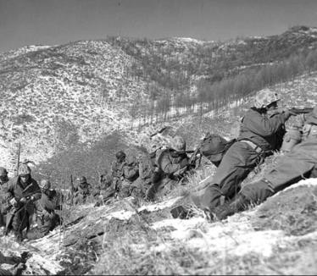
Why Manage Records?
To document and preserve the history and legacy of Marines and the Marine Corps
To document an organization’s mission-set, function, policy, decisions, procedures and essential transactions
To protect the legal and financial rights of the government and persons directly affected by Marine Corps activities

Slide 10





How are Records Managed?
Creation of Document
Records are managed according to their
lifecycle. Organizations create documents in their day to day functions. Documents are modified, updated, or moved across the organization(s) to allow for collaborative input.
Maintenance
and Use
Once a document is finalized, it is declared as an official record and retained according to its appropriate disposition schedule. In the final stages of a record’s lifecycle, it is either destroyed or sent to the National Archives and
Declared as a record
Disposition: Temporary
Records Administration (NARA) for permanent
retirement/preservation.
Disposition: Permanent

Slide 11
How are Records Managed?
Department of the Navy (DON) Record Schedules contain a description of the record as well as its NARA approved disposition (i.e. what to do with that record upon the completion of its lifecycle).
(Ex. charts, manuals or other records depicting the internal organization, relationships, function etc., cut off at the end of calendar year. Transfer to NARA 25 years after cutoff).
Records are categorized by record series (chapters), grouped together by subject or
function, activity, media format, document the relationship
(Ex. Intelligence Reports, Operating Plans, Awards etc.)
same action or other common
Where a record breaks or ends its lifecycle is referred to as the cut-off; usually occurs at the close of a fiscal or calendar year or event (i.e. investigations) in order to allow the record to be destroyed or transferred to NARA for retirement/preservation.

Slide 12
How are Records Managed?
Disposition is the NARA approved schedule for the destruction of temporary records or transfer of permanent records to NARA; it also dictates how long to store or retain records on site.
Sample DON Records Schedule
No. | Record Series Title | Description of Records | Cutoff | Disposition | Retention | Disposition Authority
5000-3 | Organizational and | Organization and functional charts, manuals, or | Calendar | Permanent: | X | DAA-NU-2015-
 | Functional Charts | other records depicting the internal organization, | year | Cut off at CY. |  | 0005-0002
 |  | relationships, functions, and status of activities and |  | Transfer to the
 |  | offices of the U.S. Navy, U.S. Marine Corps and Navy |  | National
 |  | Secretariat |  | Archives 25
 |  |  |  | years after
 |  |  |  | cutoff

Slide 13
SSICs and DON Record Schedules
It is important to distinguish between a record’s content (SSIC) and its
disposition (record schedule).
SSIC = identification of record based on subject matter
vs.
Record Schedule = disposition date affiliated with record type
Ex. An appointment letter may be created in reference to training (SSIC 3300), however, it should be filed under Record Schedule 5000-1 (General Correspondence) because that is the “bucket” which handles/disposes of appointment letters.
Ex. The Marine Corps Order regarding Awards uses SSIC 1650 to identify content,
however it is filed under Record Schedule 5000-8 (Directives Case Files).

Slide 14
SSICs and DON Record Schedules
SSICs stand for Standard Subject Identification Code
When a record is created, it is assigned the SSIC that most closely describes its subject, purpose or significance
Once an SSIC is assigned, use the Command Records Operational Support Site (CROSS: https://eis.usmc.mil/sites/cross ) or the DON Record Schedule List found on the SECNAV portal to “crosswalk” that SSIC to its corresponding Record Schedule: https://portal.secnav.navy.mil/orgs/DUSNM/DONAA/DRM/Records-and-Information- Management/Approved%20Record%20Schedules/Forms/AllItems.aspx
All RMs are responsible for completing the “crosswalk” of SSICs to the DON Record
Schedules and should incorporate record schedules into their respective file plans.

Slide 15
SSICs and DON Record Schedules
The new DON Record Schedule dispositions replace the SSIC dispositions listed within SECNAV M-5210.1 and should now be adopted for everyday use
This reduces approximately 6,000 SSICs to ~712 Record (Disposition) Schedules
Retention periods are longer than those listed in SECNAV M-5210.1 RMs now manage fewer record dispositions
Since retention periods have been extended, it is important to identify the new dispositions schedules in order to prevent unauthorized destruction of records

Slide 16
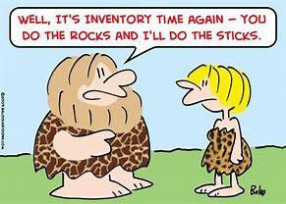
Creating a Records Inventory
A records inventory is a list of each record series within an organization. It identifies the amount of records and any problem areas that would prohibit the migration of records from paper to an electronic format. A records inventory can be created by determining:
Who has records?
Designate RM points of contact and create an organizational hierarchy to capture all offices, sections, subsections etc. with records
What records are created?
Determine the type and value of the records created and/or maintained throughout the organization (i.e. temporary, permanent, historical, financial, administrative etc.)

Slide 17
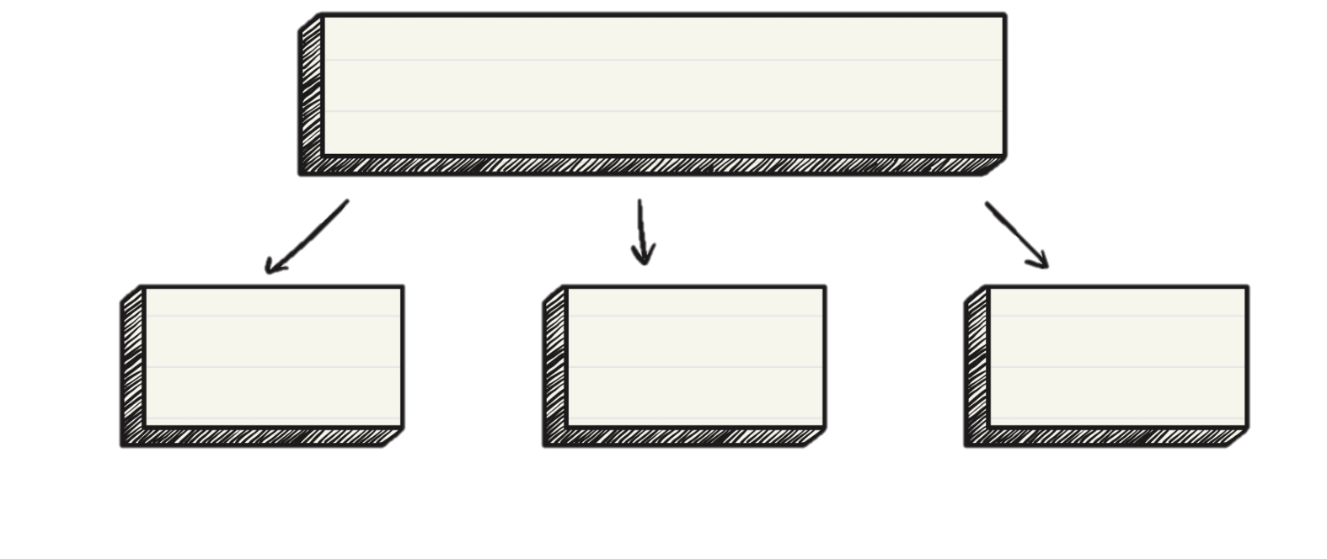
Creating a Records Inventory
“To get to where you need to be, you need to know where you are at.”
Questions to Consider
Where
Why
How
Where the records are located?
Why are the records located there?
Consider whether or not the record’s
location is in compliance with ERM policy requirements; if not, what action(s) will be taken to meet those standards?
How are the records managed?
Are the records properly identified? The disposition followed? Are the records protected, with proper access?
Determine volume, storage media (i.e. system of record, hard drive etc.), and equipment used (i.e. file
cabinet, computer etc.)

Slide 18
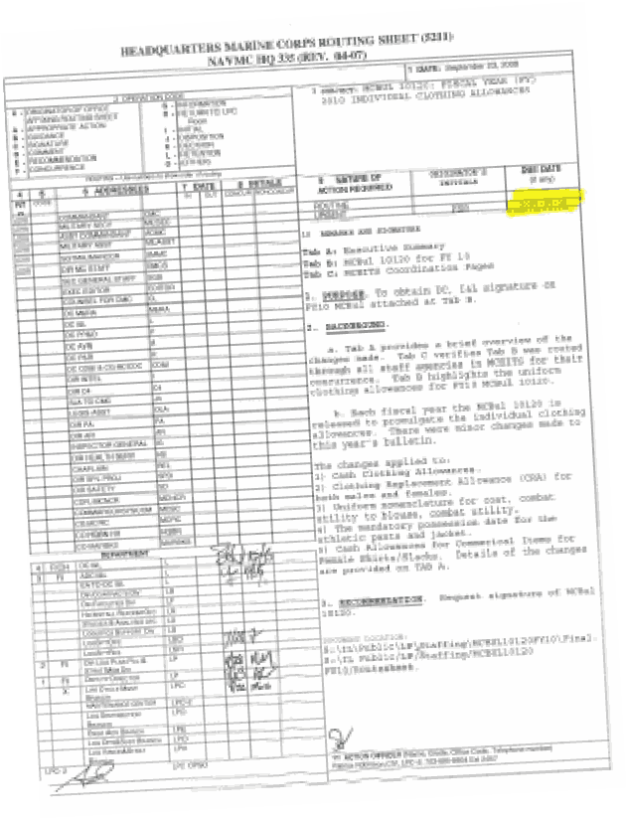
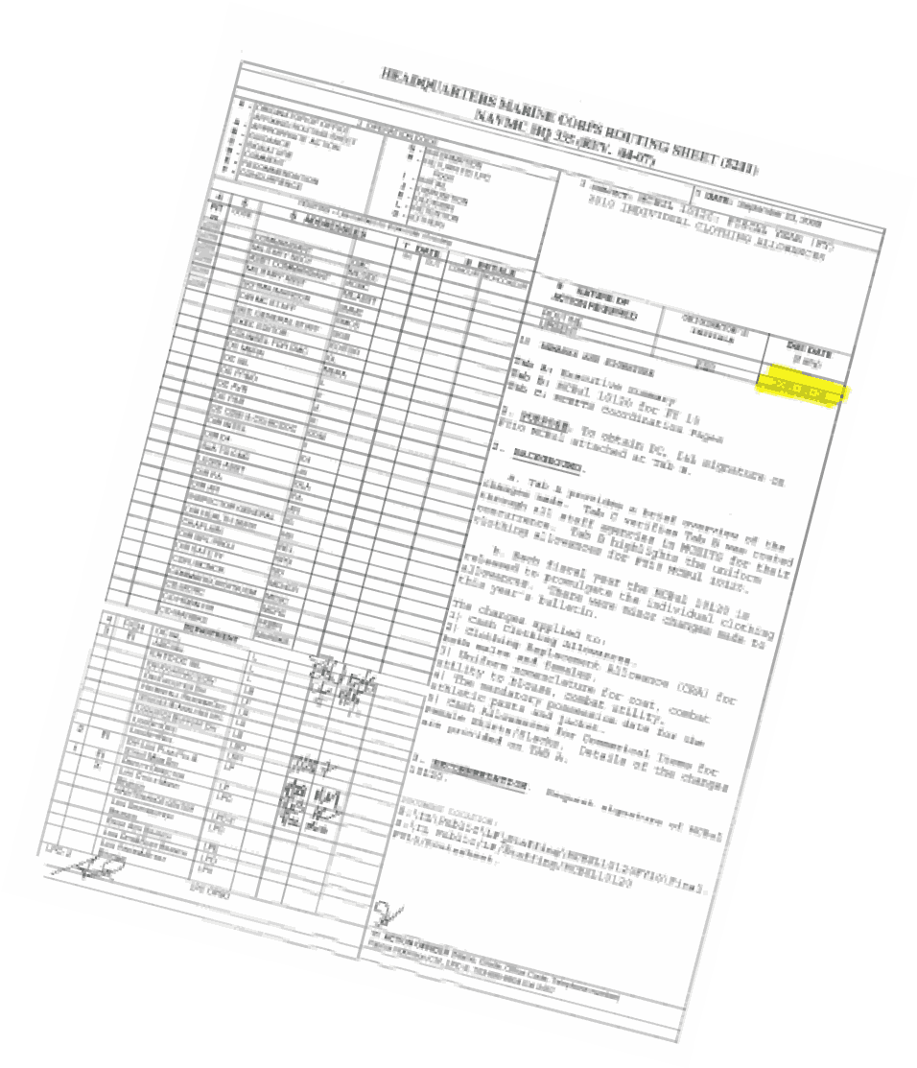
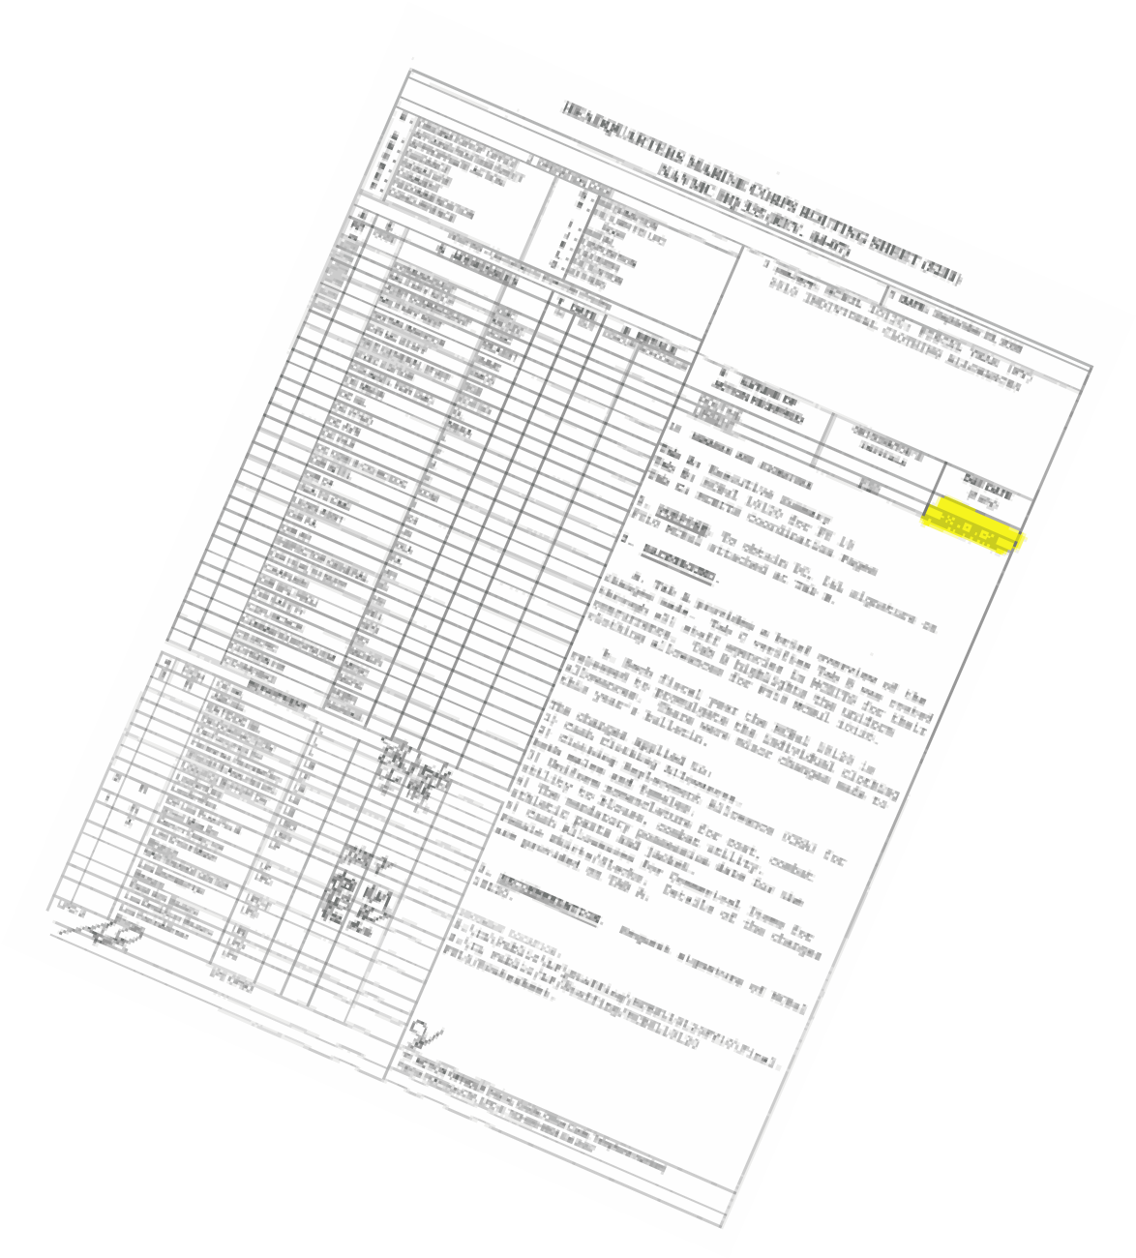
Types of Records
There are two types of records unique to all organizations:
TEMPORARY
Retained for a specific time period
Can be designated short-term (less than 3 years) or long-term (greater than 3 years)
Destroyed according to disposition instructions
contained within the DON Record Schedules
Ex: General Correspondence or Civilian Personnel Records

Slide 19





Types of Records
PERMAMENT
Has enduring value (historical, research, legal, scientific, cultural etc.)
Protects the interests of the Marine
Corps
Documents Marine Corps missions, functions, responsibilities, and significant experiences and accomplishments
Transferred to NARA for long-term preservation/retirement
Ex. Official Military Personnel File records, Operational Armed Conflict records or Organizational Policies

Slide 20
What is the Difference?
LEGAL HOLDS
FROZEN RECORDS
Records held for the purpose of litigation, audit or investigation
Issued by General Counsel
Placed on the records in an organization’s
physical custody.
ARDB provides Command Designated RMs notice to suspend the normal disposition cycle of the records mentioned in the hold notice
Placed on records in the physical custody of Federal Records Centers (FRC)
Disposition temporarily suspended due to special circumstances
Requires request for suspension and NARA approval

Slide 21
File Plan
The starting point for an organization’s RM Program
Identifies all records created across the organization utilizing record schedules Inspected internally (once a year) and created electronically in CROSS:
https://eis.usmc.mil/sites/cross
Contains the following: Record Schedule, Series Title, Record Description, Disposition and Disposition Authority.
An electronic file plan created in CROSS includes the format (paper or electronic) and location (Sharedrive, SharePoint, file cabinet, desktop, System of Record etc.) of a record, as well as any policy exclusions that would prevent a paper record’s migration to an electronic format.

Slide 22

What is Electronic Records Management?
Electronic Records Management (ERM) is information or data files that are created and stored in a digital format through the use of computers and other applications software.
Electronic records managed in a Department of the Navy (DON) approved records management applications (RMA) must include the appropriate disposition and metadata.
DON Tasking, Records, and Consolidated Knowledge Enterprise Repository (DON TRACKER) is an example of an approved RMA.

Slide 23
Electronic Records Management
Per OMB M-19-21, DOD 5015.02-STD, and NARA, all federal agencies will manage both permanent and temporary records throughout their lifecycle in accessible electronic formats by December 31, 2022.
To meet policy requirements, ARDB has outlined a “Three Phased Approach” to move the Marine Corps to ERM compliance.
ERM tools/resources are available to support RMs in meeting NARA,
DON, and USMC policy requirements

Slide 24
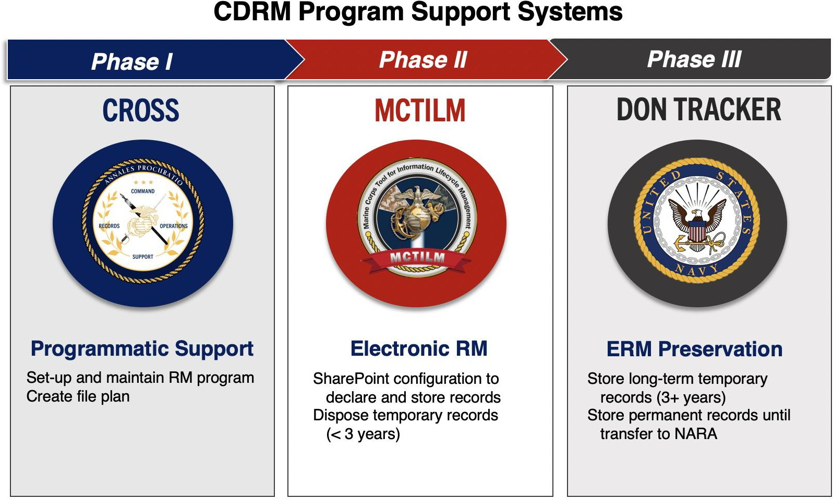
Electronic Records Management

Slide 25
Electronic Records Management
CROSS
A SharePoint tool designed to help CDRMs standup and maintain their RM Program per MCO 5210.11F requirements. CROSS is command focused, a “one stop shop” designed to replace traditional turnover binders and automate 5210 IG Functional Area Checklist. It also serves as a means of identifying all USMC records, giving both ARDB and IGMC purview over command progress to ERM.
MCTILM
A customized SharePoint solution, designed to automate NARA approved disposition schedules by assigning critical metadata to records captured within SharePoint. Holds 100% of records (both Temporary and Permanent) and automatically disposes of records according to their appropriate lifecycle.
DON TRACKER
DON TRACKER
The official RM repository for DON and USMC. A licensed based system that will house long term temporary (greater than 3 years) and permanent records until transfer to NARA. Only requires SharePoint Site Collection Administrator (SCA) or CDRM access.

Slide 26
RM Best Practices
Establishing best practices helps mitigate risks and ensures records are managed consistently.
Obtain the support of leadership within your organization and develop standard operating procedures
Conduct a records inventory to identify all records created across the organization
Ensure records are classified by content, record type, record series, and all metadata associated with the record
Crosswalk SSICs to the DON Record Schedules in order to apply the correct disposition to records Create a file plan to document location and format of records created in your area of responsibility Use electronic tools and resources (i.e. CROSS/MCTILM/DON TRACKER) to automate RM processes
and lifecycle records management
Train personnel on RM processes and procedures

Slide 27
RM Policy and References
DON/USMC References
SECNAVINST 5210.8F | DON Record Management Program
SECNAV M-5210.2 | DON Standard Subject Identification Code (SSIC Manual)
SECNAV M-5210.1 CH 1 | DON Records Management Program Records Management Manual
MCO 5210.11F | Marine Corps Order for Records Management
For a complete list of current RM Policies, refer to the Records Management Policy Matrix in CROSS at: https://eis.usmc.mil/sites/CROSS

Slide 28


RM Support Staff
HQMC Records, Reports, Directives and Forms Management Section (ARDB)
David Spenner – Section Head david.spenner@usmc.mil
Derrick Terry – Records Program Manager derrick.terry@usmc.mil
CONTRACT SUPPORT
Hartwood Consulting Group
Program Manager – Talia Bastien
540-210-0113 talia.bastien.ctr@usmc.mil
Outreach Coordinator– Leira Ortiz Velez
540-210-0119 leira.ortizvelez.ctr@usmc.mil
Service Desk Support – Andrew Van Corbach
540-210-0128 andrew.l.vancorbach@usmc.mil
Training Support Specialist – Dela Ashe 540-210-0087 dela.ashe.ctr@usmc.mil
ARBD OUTREACH SUPPORT
smb_hqmc_rm_outreach@usmc.mil
(703) 614-1081 / DSN 224-1081
Command Records Operational Support Site
https://eis.usmc.mil/sites/CROSS

